Slide 1
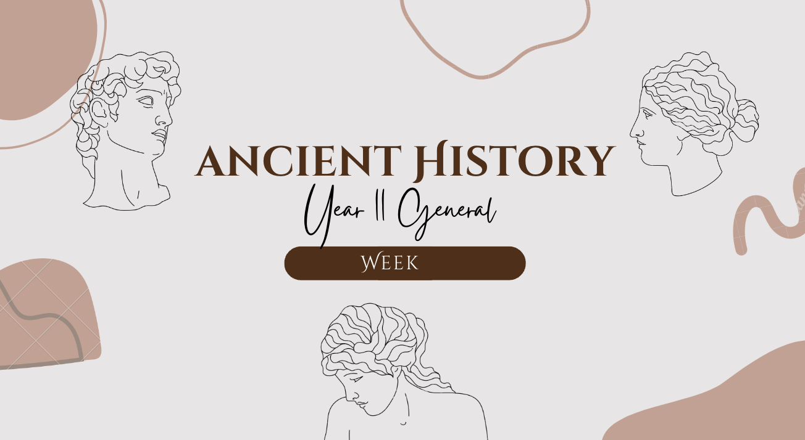
1
TITLE: Historical sources GOAL/S: Review historical sources
Lesson 2
Ms Barrie

Slide 2
Today’s Lesson
Review types of historical sources
Practice Source Analysis
Identify source analysis terms/questions

Slide 3


What do you already know about ‘Source Analysis’?
Discussion question

Slide 4
Historical Source Analysis
Comes from the Greek historia, meaning ‘learning by inquiry’
Historians ask questions of the past depending on focus and aims of research
FOCUS: social, political, economic, religious, and military, cultural structures
We use sources to discover the past
Examine the physical remains of the past to reconstruct moments in history
In Ancient history we don’t just look at primary and secondary sources
Ancient vs. Modern
Archeological vs. written

Slide 5
Types of Sources
REVIEW: Primary and Secondary
PRIMARY
Created AT/AROUND time being studied
Objects
Writings
Pictures
SECONDARY
Created AFTER time being studied
Textbooks
Podcasts
Pictures/Photographs

Slide 6
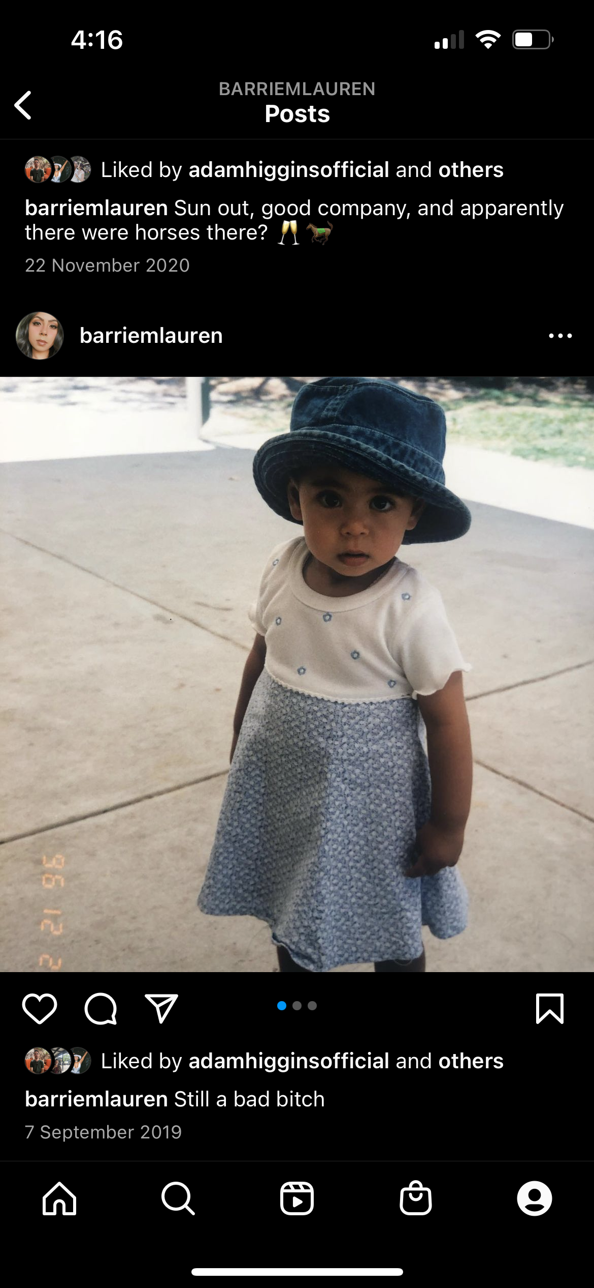
Types of Sources
REVIEW: Primary
PRIMARY
Created AT/AROUND time being studied
Objects
Writings
Pictures
c. 1996 CE

Slide 7
Types of Sources
REVIEW: Secondary
SECONDARY
Created AFTER time being studied
Textbooks
Podcasts
Pictures/Photographs
c. 2019 CE

Slide 8
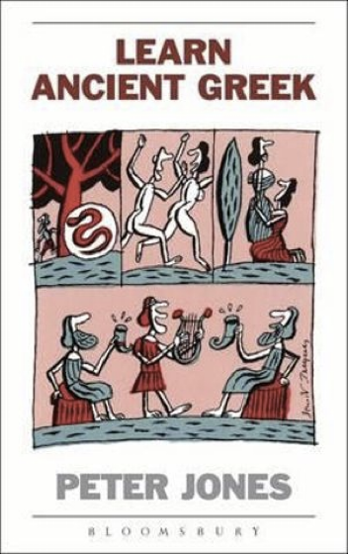
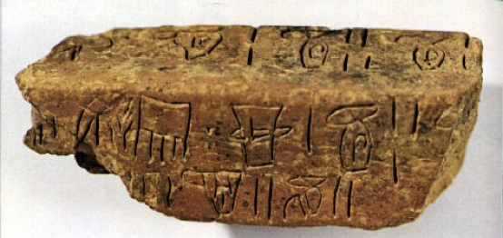
Types of Sources
Ancient and Modern
ANCIENT
From the start of recorded human history to the Medieval Period
Ancient Greek evidence of writing
MODERN
Anything AFTER the Medieval Era
An Ancient Greece Textbook

Slide 9
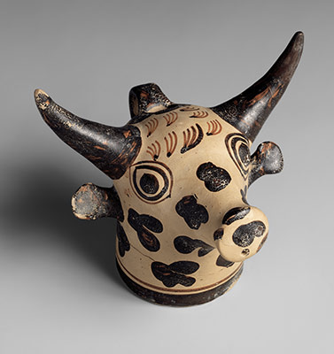
Types of Sources
Archaeological vs. Written
ARCHAEOLOGICAL
Physical remains/Artefacts
Minoan Bull-Head Vase
WRITTEN
Materials/Objects with text/writing
Ancient Greek Evidence of Writing

Slide 10
IMPORTANT NOTE:
SOME sources can fit more than one category/type!

Slide 11
Which sources are we LIKELY to analyse in Ancient History? Which sources are IMPOSSIBLE for us to analyse as ‘Ancient’ Sources?
Discussion questionS

Slide 12
Common Questions:
VERB | TOPIC
Identify | Type of Source
Explain | Historical context
Compare/Contrast | Message
Evaluate | Usefulness
Identify/Discuss | Perspective
Evaluate | Extent of insight

Slide 13
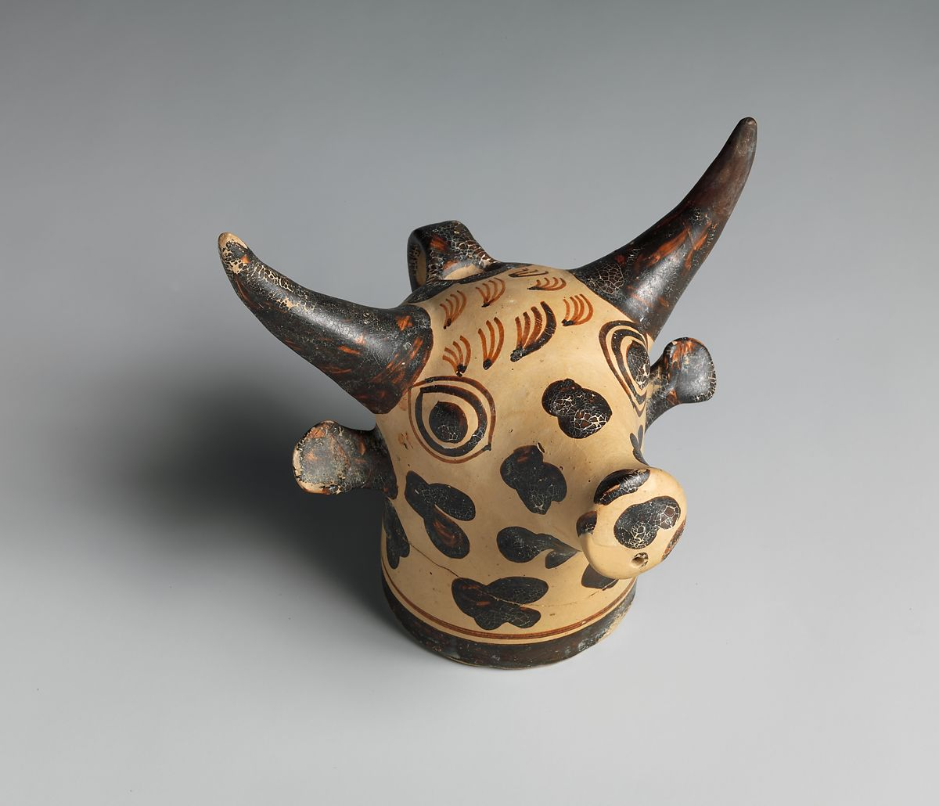
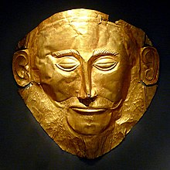
ACTIVITY – Practice source Analysis
In groups, you will receive ONE (1) Minoan and ONE (1) Mycenaean source
Practice analysing as a group

Slide 14
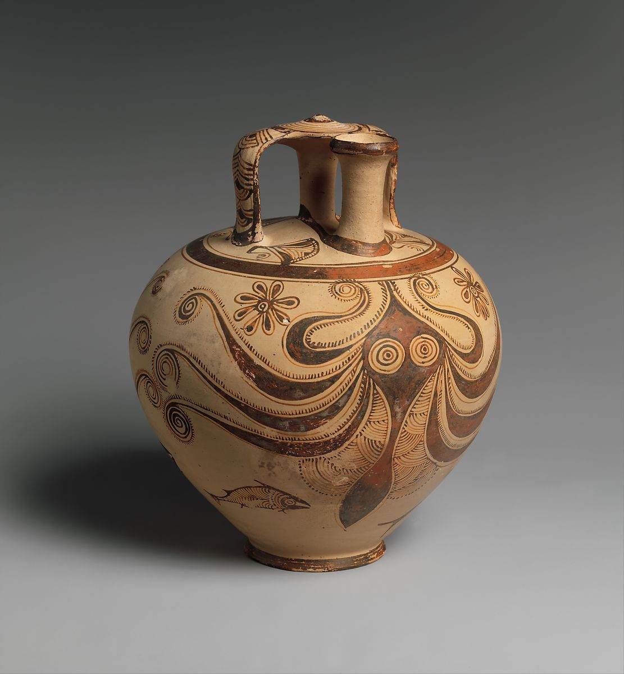
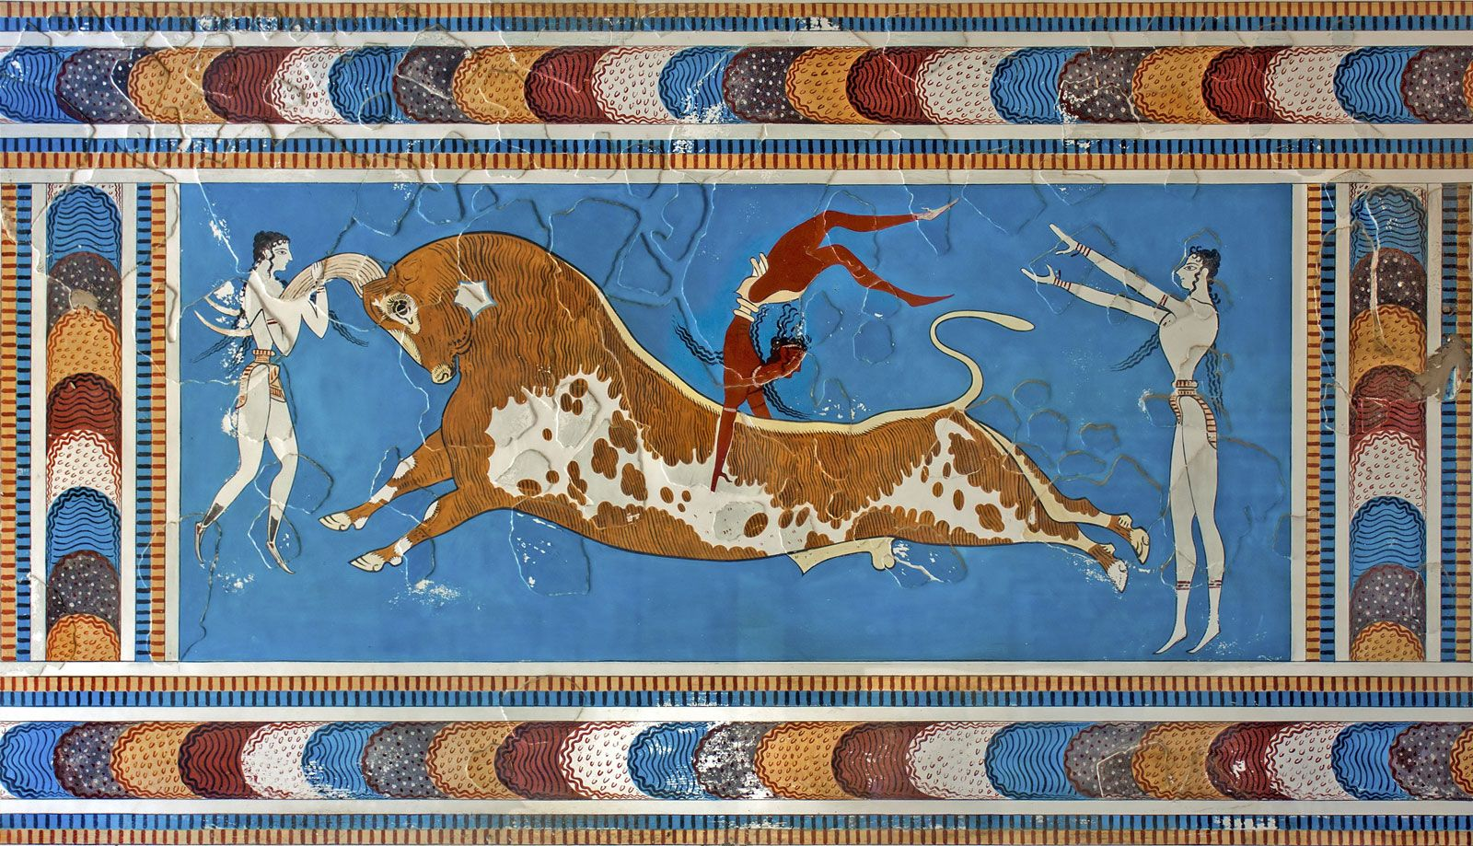
MINOAN: Terracotta vase in the form of a bull's head c. 1450–1400 BCE
MYCENAEAN: Death Mask known as the ‘Mask of Agamemnon’
c. 1500 BCE
MINOAN: Toreador Fresco
c. 1550 BCE
MYCENAEAN: Terracotta Stirrup Jar with octopus
c. 1200 – 1100 BCE

Slide 15
Summary
1. Define ‘historical source’?
SENTENCE STARTER: A ‘Historical Source’ is …
Write 2 pieces of advice to successfully analyse a source.
A:
B:

